Slide 1
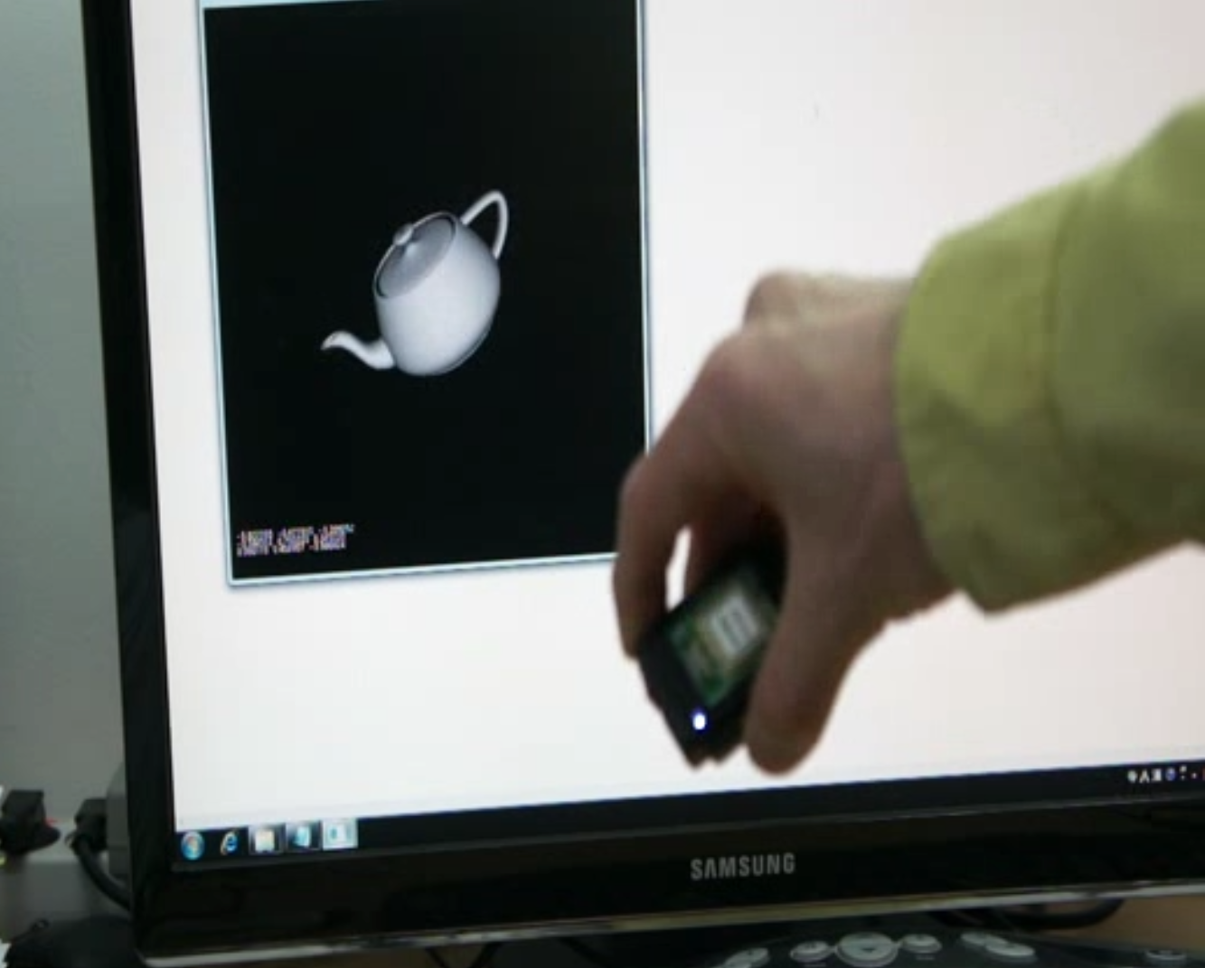
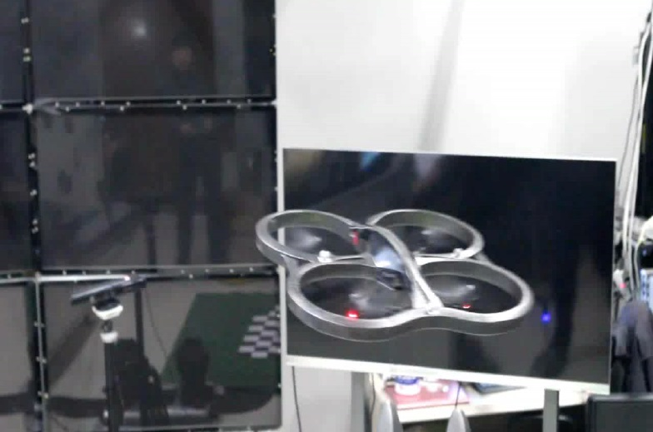
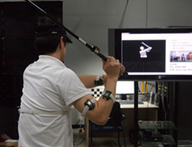
Unscented Kalman Filtering for Simultaneous Estimation of Attitude and Gyroscope Bias
Donghoon Kang^{1,2}, Cheongjae Jang¹, and Frank C. Park¹
¹Seoul National University
²Korea Institute of Science and Technology
Proposing the state dynamics and measurements in a way that leads to “closed-form” equations for covariance propagation and update in a matrix Lie group setting.
Presenting an alternative form of the covariance of the solution to Wahba’s Problem, which is more efficient and accurate.

